Slide 1
The Renaissance
Outcome: Renaissance Writers

Slide 2
What qualities do people look for in a leader?

Slide 3
What leadership qualities are good for a country?

Slide 4
In terms of running a country, can the end justify the means?

Slide 5
Renaissance Writers
Changes
Many writers followed Dante who wrote in the vernacular
Vernacular: Writers wrote in their native language rather than Greek or Latin
This could include Italian, German, English, and French
Renaissance writers wrote for self-expression or to portray the individuality of their subjects- started trends that modern writers still follow

Slide 6
Dante

Slide 7
Renaissance Writers
Dante
Italian poet, writer, theorist, philosopher, and political thinker
Born in Florence, Italy
Referred to as the “Father of the Italian language”
Wrote “The Divine Comedy”
Epic poem about Dante’s travels through Hell, Purgatory, & Heaven
Broken up into 3 parts: Inferno, Purgatorio, and Paradisio

Slide 8
For you gamers out there…

Slide 9
Petrarch

Slide 10
Renaissance Writers
Petrarch
Sometimes called the father of humanism
Great poet- wrote in both Italian and Latin
Wrote sonnets (14 line poems) about a mysterious woman named Laura
Little is known of Laura other than she died of plague in 1348

Slide 11
Sonnet about Laura
Sonnet 292
The eyes I spoke of once in words that burn, the arms and hands and feet and lovely face that took me from myself for such a space of time and marked me out from other men;
the waving hair of unmixed gold that shone, the smile that flashed with the angelic rays that used to make this earth a paradise, are now a little dust, all feeling gone;
and yet I live, grief and disdain to me, left where the light I cherished never shows, in fragile bark on the tempestuous sea.
Here let my loving song come to a close; the vein of my accustomed art is dry, and this, my lyre, turned at last to tears.

Slide 12
How does one get to be the Father of Humanism?
By putting classical philosophical ideas into a Christian framework–at least that’s how Francesco Petrarca did it. In Roman Catholic Europe many of the ideas of ancient Greece and Rome were not likely to be accepted unless they could be reconciled with the Christian faith, and Petrarch did so in his writings. His basic idea was that the study of mankind, as such, was a viable and important field for Christian people, thus laying the groundwork for later Renaissance figures to read and popularize classical history, literature, and philosophy–with its “man as the center of all things” foundation point.

Slide 13
Boccaccio

Slide 14
Renaissance Writers
Boccaccio
Wrote the Decameron
Told in Italy during the Black Death
About 7 women and 3 men who hide in a villa for two weeks and tell a different story each night
A series of realistic, sometimes off-colored stories
The Decameron presents both tragic and comic views of life

Slide 15
The Decameron

Slide 16
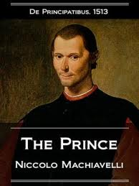
Machiavelli

Slide 17
Renaissance Writers
Machiavelli
Wrote The Prince
Explains how a ruler can gain power and keep it in spite of his enemies
Said most people are selfish, fickle, and corrupt
Not concerned with what was morally right but what was politically effective
This may involve misleading your people

Slide 18
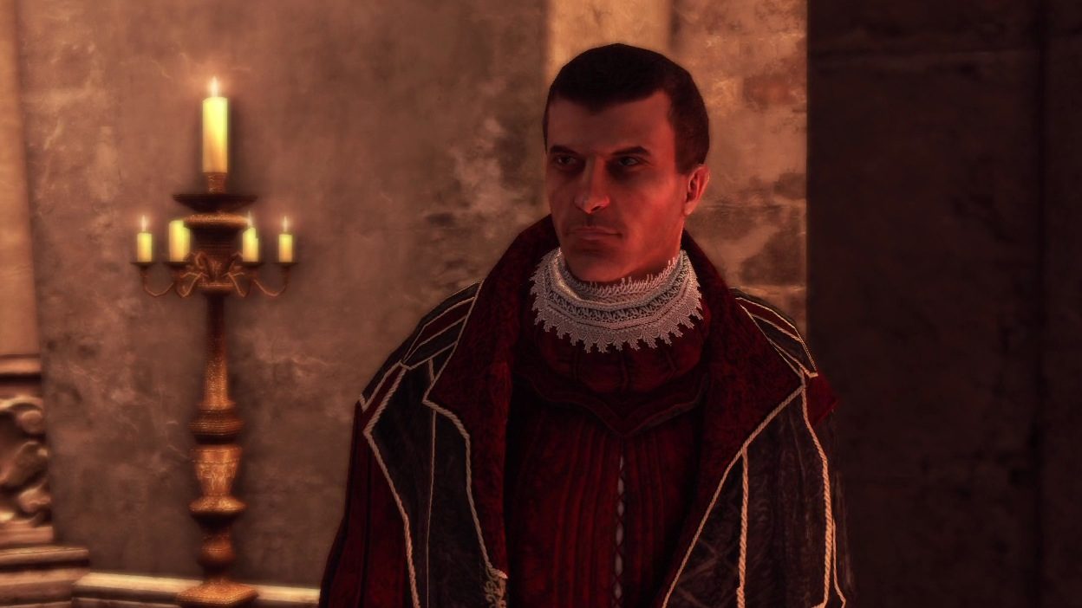
Machiavelli in Assassin’s Creed

Slide 19
Northern Renaissance Writers
William Shakespeare
Thomas More

Slide 20
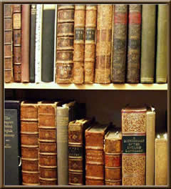
Renaissance Writers
Result: Renaissance writers wrote in vernacular and about people and life rather than about God and set many trends that are still used today by modern writers.

