Slide 1
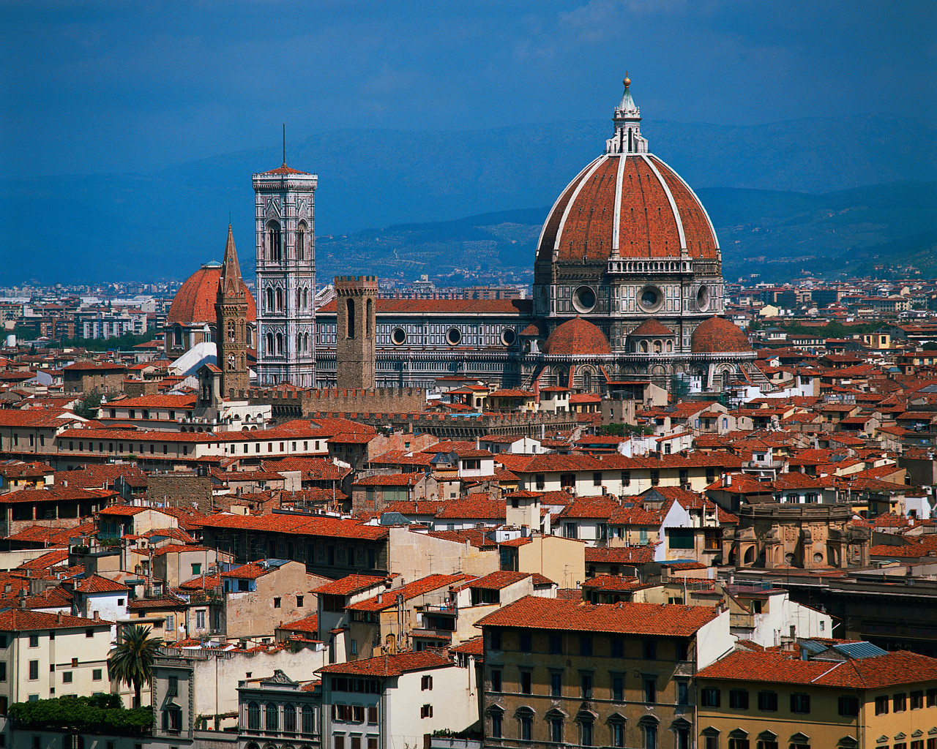
The Renaissance Outcome: Renaissance Painters/Sculptors
Florence

Slide 2
The Renaissance
Renaissance Art
Artists were supported by patrons like Isabella d’Este and the Medici
Medieval artists used religious subjects to convey a spiritual ideal
Renaissance artists will portray religious subjects but will use realistic styles copied from classical models & Greece and Rome
Renaissance painters used perspective which showed three dimensions on a flat surface with a vanishing point in the middle
Often times fresco was used: painting on wet plaster

Slide 3
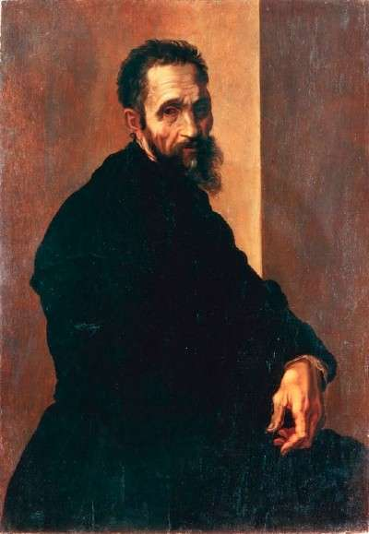
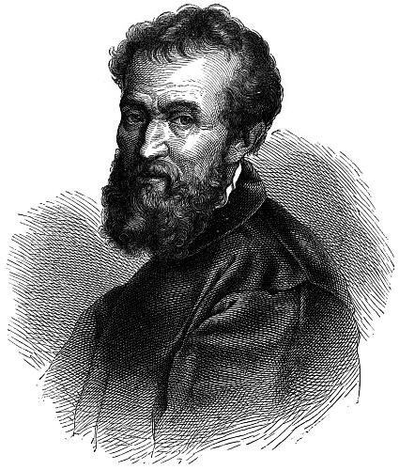
Michelangelo

Slide 4
Famous Artists
Michelangelo
Renaissance man: sculptor, painter, architect, and poet
Famous for way he portrayed the human body
Famous works:
Statue of David,
Ceiling of the Sistine Chapel,
Dome of St. Peter’s

Slide 5
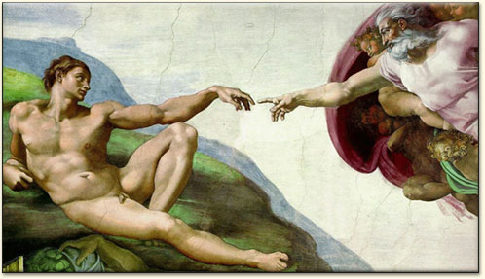
Sistine Chapel Ceiling

Slide 6
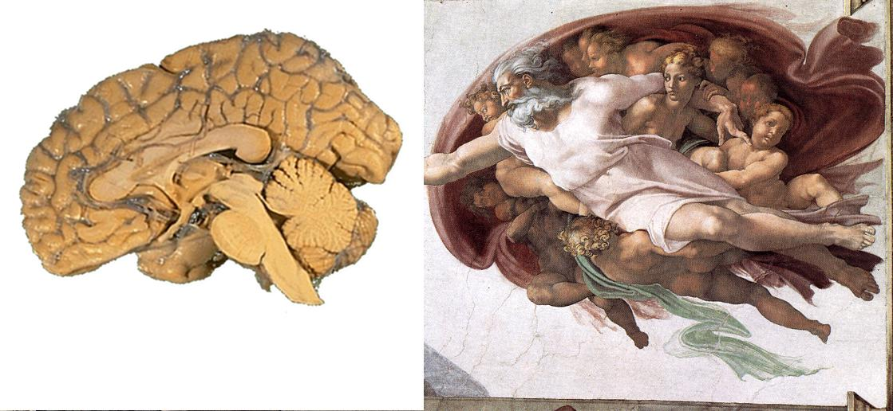

Slide 7
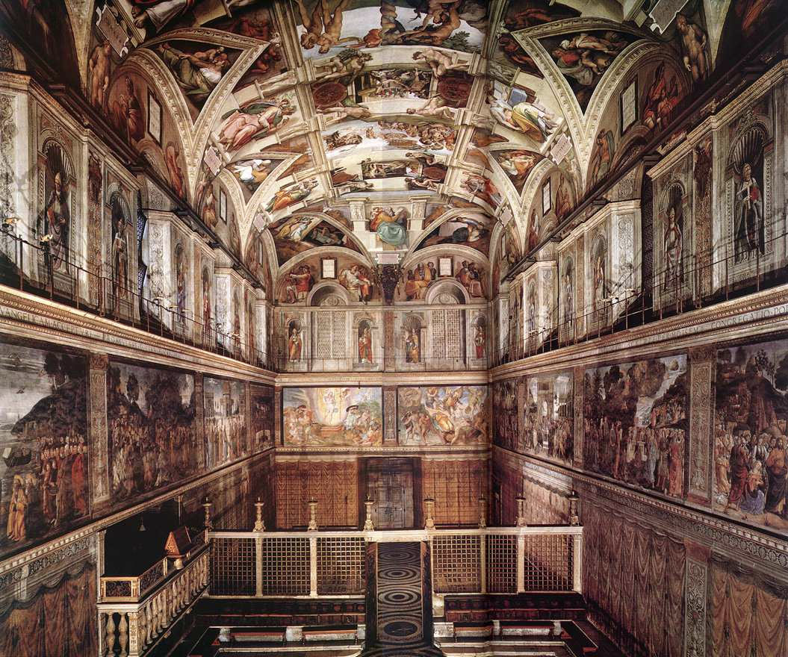

Slide 8
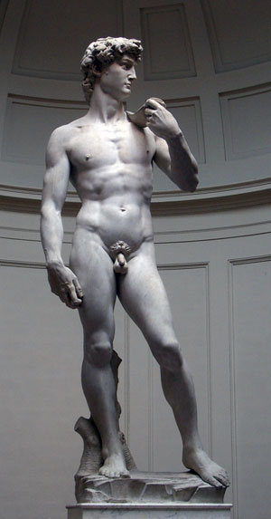
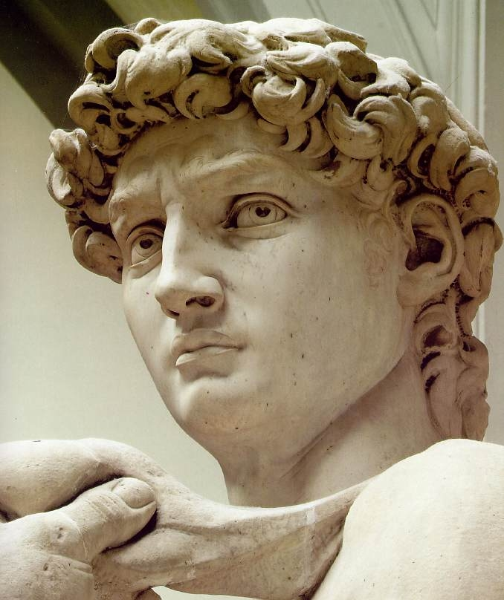
David

Slide 9
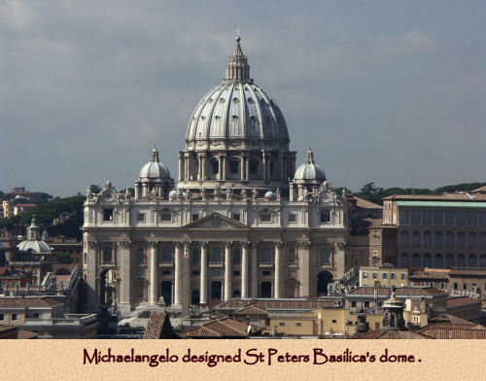

Slide 10
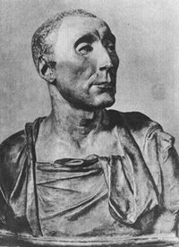
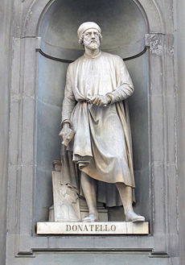
Donatello

Slide 11
Famous Artists
Donatello
Made sculpture more realistic by carving natural postures and expression that revealed personality.
Equestrian Statue of Gattamelata
Also sculpted a David- favorite subject of Renaissance sculptors

Slide 12
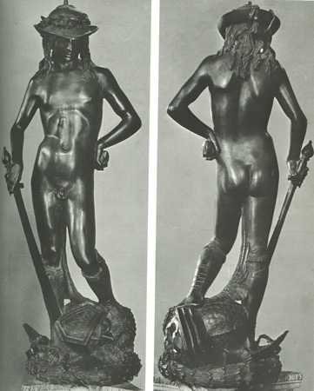
Donatello’s David

Slide 13
Donatello’s Equestrian Statue of Gattamelata

Slide 14
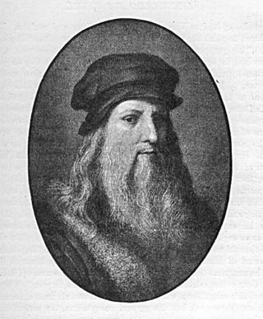
Leonardo da Vinci

Slide 15
Famous Artists
Leonardo da Vinci
Painter, sculptor, inventor, and scientist
Interested in how things work (veins in a leaf and muscle work)
Famous works:
The Mona Lisa
The Last Supper
Virgin on the Rocks
The Da Vinci Code featured many of his paintings

Slide 16
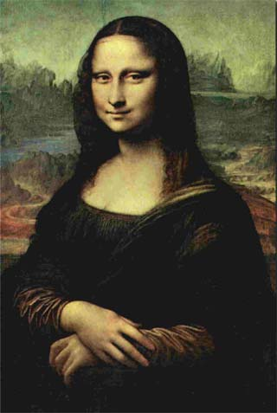
The Mona Lisa

Slide 17
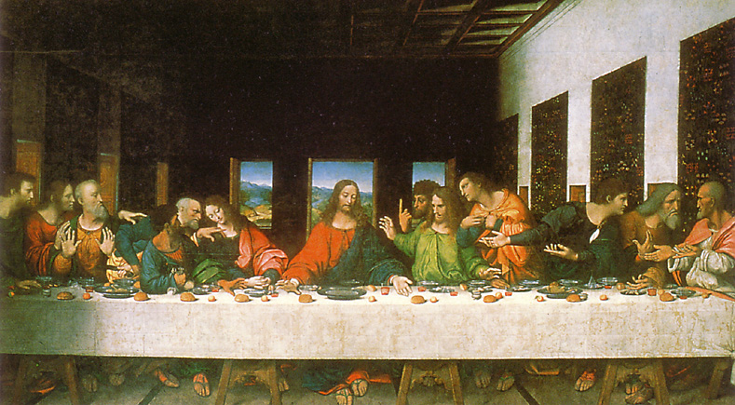
The Last Supper

Slide 18
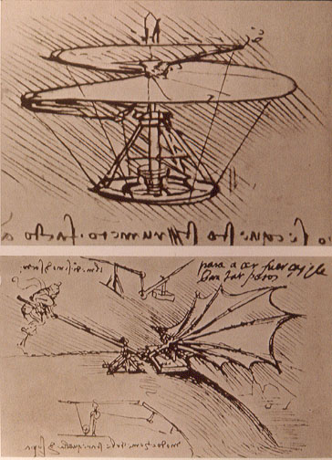
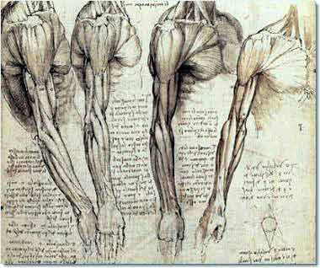
Da Vinci Sketches

Slide 19
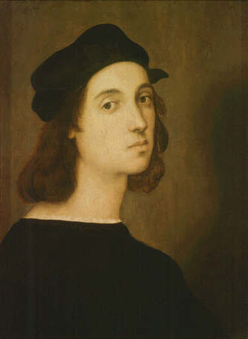
Raphael

Slide 20
Famous Artists
Raphael
Learned from studying Leonardo and Michelangelo
One of favorite subjects was Madonna and Child (Virgin mary)
Famous works:
School of Athens
Marriage of the Virgin

Slide 21
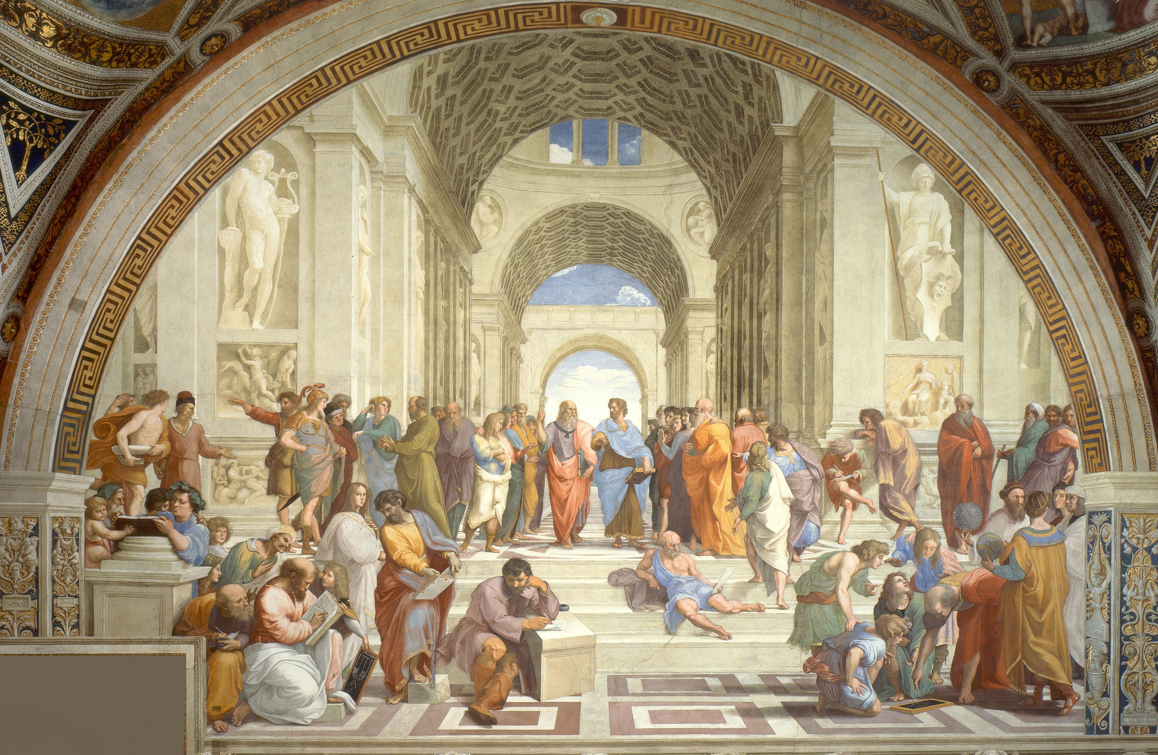
School of Athens

Slide 22
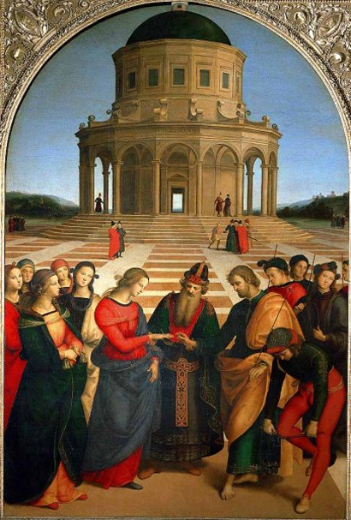
Marriage of the Virgin

Slide 24
Others: Botticelli’s Birth of Venus

