Slide 1
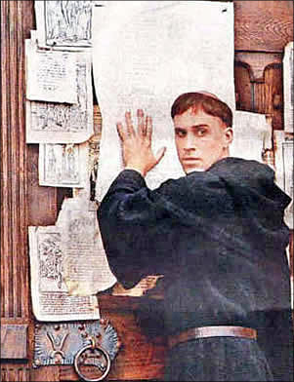
The REformation
Outcome: Martin Luther and the Reformation

Slide 2
The Reformation
Setting the stage:
By the tenth century, the Roman Catholic Church dominated religious life in Northern and Western Europe.
Many people began to criticize the Church’s practices
People felt that Church leaders were too interested in worldly pursuits, such as gaining wealth and political power

Slide 3
The Reformation
Reformation: A movement of religious reform.

Slide 4
2. Causes of The Reformation
Social
Renaissance values let to people to question the Church
The printing press helped to spread ideas critical of the Church
Political
Monarchs (kings) challenged the Church as the supreme power in Europe
Many leaders viewed the pope as a foreign ruler and challenged his authority

Slide 5
2. Causes of The Reformation
Economic
European princes and kings were jealous of the Church’s wealth
Merchants and others resented having to pay taxes to the Church
Religious
Some Church leaders had become worldly (secular) and corrupt
Many people found Church practices such as indulgences as unacceptable

Slide 6
2. Causes of The Reformation
Other examples:
Pope Alexander VI admitted that he had fathered several children
Many priests and monks were poorly educated and couldn’t teach people
Other clergy married, drank, or gambled
Simony, Lay investiture, and the age old division of Church vs. State

Slide 7
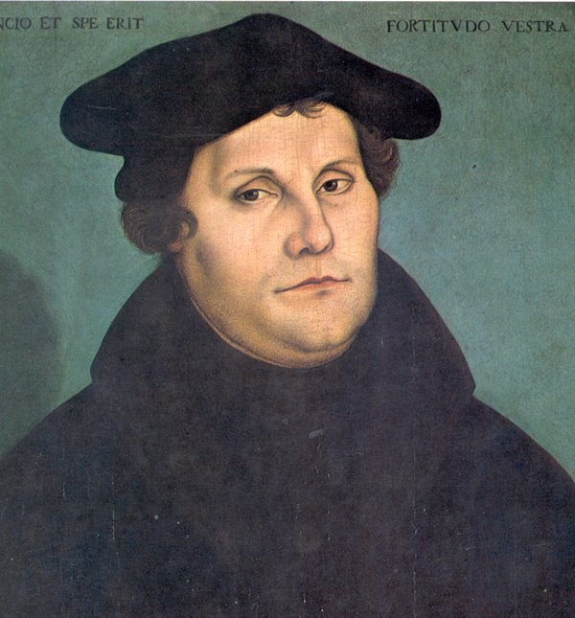
Martin Luther

Slide 8
Martin Luther and the Reformation
Luther Challenges the Church
Martin Luther
Parents wanted him to be a lawyer, became a monk and teacher instead
Taught scripture at University of Wittenberg in German state of Saxony
His 95 Theses began the Reformation
Martin Luther believed it was ok for clergy tomarryand he did so

Slide 9
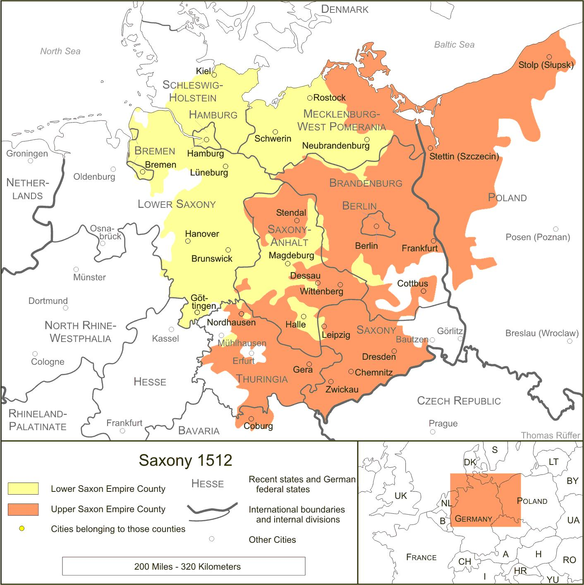

Slide 10
Martin Luther and the Reformation
95 Theses
Luther took a stand against Johann Tetzel who was selling indulgences to pay for the rebuilding of St. Peter’s Cathedral in Rome
Indulgences: A pardon which released a sinner from performing the penalty a priest imposed for sins.
Indulgences were not supposed to affect God’s right to judge
Tetzel gave people impression that they were buying their way into heaven
On October 31, 1517 Martin Luther posted his 95 Theses on the door of the castle church in Wittenberg
The 95 Theses were formal statements attacking “pardon-merchants”
Martin Luther’s actions began the Reformation

Slide 11
Caricature of Pope Alexander VI by Martin Luther, 1545

Slide 12
Martin Luther and the Reformation
Luther’s Teachings
Good works not needed for salvation, a person could win salvation based on faith
Church teachings should be based on Bible not pope or Church traditions which could be corrupt or false
Priests not needed to interpret the Bible because all people with faith were equals

Slide 13
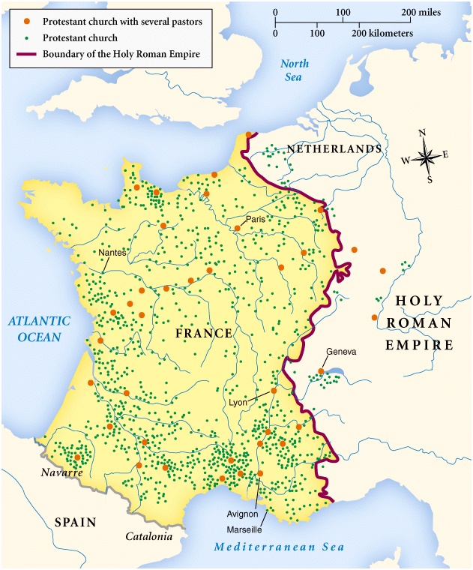
Protestant Churches in France (Late 16^{c})

Slide 14
Martin Luther and the Reformation
Response to Luther
Pope Leo X threatened Luther with excommunication if he didn’t take back his statements
Instead of taking statements back, Luther burned the pope’s decree
Leo then excommunicated Luther
Holy Roman Emperor Charles V (Catholic) summoned Luther to Worms in 1521 to recant (take back) his statements
Charles issues Edict of Worms ---> declared Luther an outlaw and heretic and no one was to give him food or shelter
Frederick the Wise of Saxony sheltered Luther ---> While there Luther translated the New Testament into German
In 1522 Luther returned to Wittenberg and his followers became known as Lutherans
The princes in Germany that supported Luther banded together to protest against those who were against Luther’s ideas, became known as Protestants

Slide 15
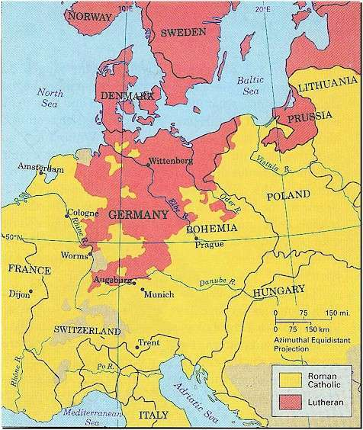

Slide 16
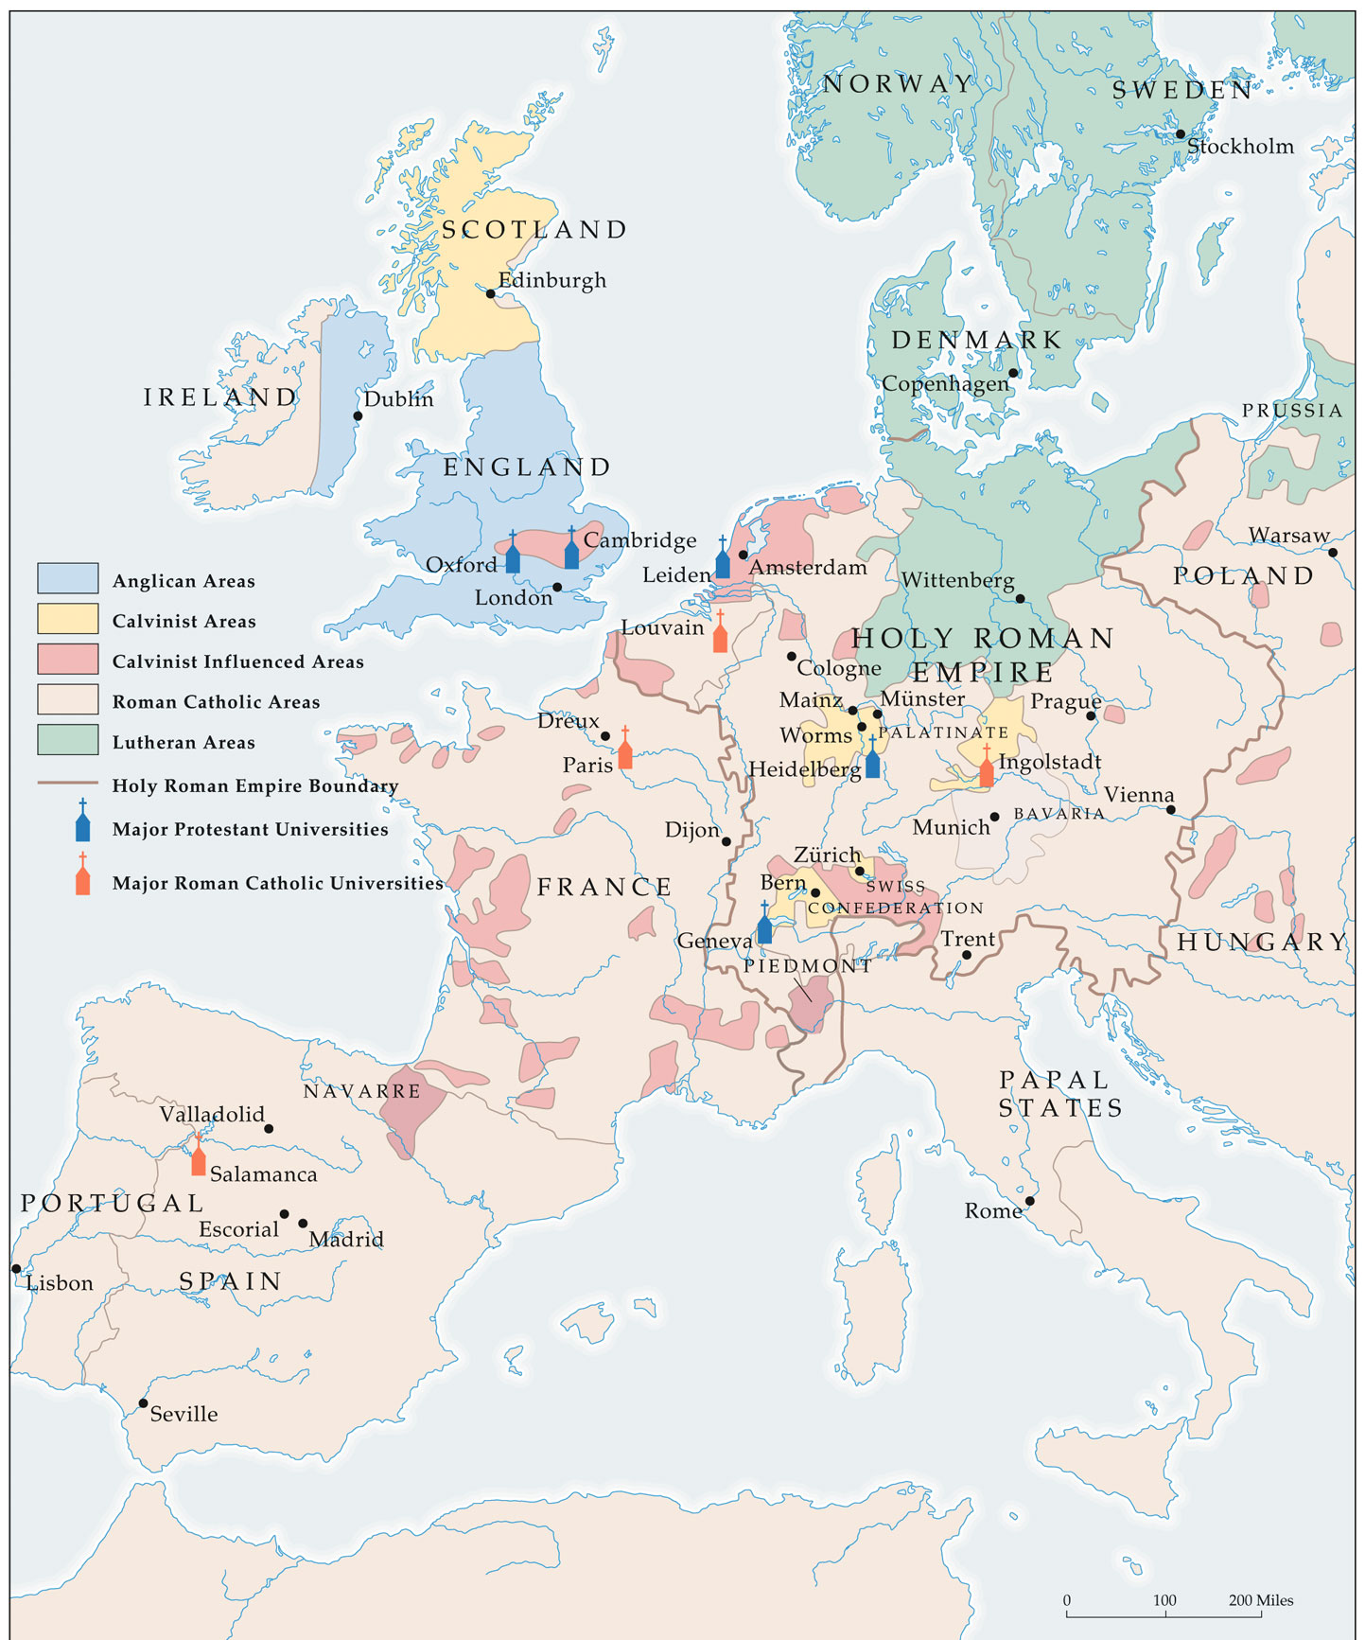
Reformation Europe (Late 16^{c})

Slide 17
Result: Because of Martin Luther’s actions, Christianity has two main branches in the Western world: Catholicism and Protestantism.

