Slide 1
The Age of Exploration
Outcome: The Atlantic Slave Trade

Slide 2
Question
Should Christopher Columbus be blamed (vilified) for the eventual genocide of several major civilizations, and the legacy of the slave trade?

Slide 3
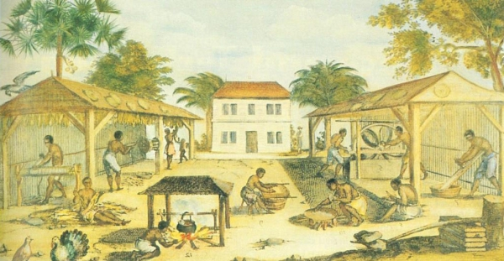
The Atlantic Slave Trade
Setting the Stage:
Sugar plantations and tobacco farms required a lot of labor to turn a profit
Native Americans were cheap but millions died from disease, warfare, and brutal treatment

Slide 4
The Atlantic Slave Trade
The Causes of African Slavery
Slavery had existed in Africa for centuries but was relatively minor
Muslim traders ushered in an increase of slavery in Africa in the 7th century
Muslims transported about 17 million African slaves from 650-1600
In African and Muslim slavery, slaves had some legal rights and social mobility
Africans were immune to the disease that killed many natives
Many Africans had experience with farming
Africans weren’t likely to escape due to unfamiliarity with the new land
If escaped, skin color made it easier to catch
By the end of the Atlantic slave trade, Europeans had transported 9.5 million Africans to the Americas

Slide 5
African Captives in Yokes

Slide 6
The Atlantic Slave Trade
Slavery Spreads Throughout the Americas
Spain and Portugal led the way with transportation of slaves
During the 17th century, more than 40% of all Africans brought to the Americas went to sugar plantations in Brazil
As England’s presence in the Americas grew, it came to dominate the slave trade
African society was broken up into tribes
Many African rulers and merchants captured other Africans and traded with European traders for gold, guns, and other goods

Slide 7
“Black” Gold for Sale!

Slide 8
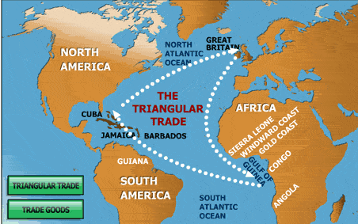
Triangle Trade

Slide 9
The Atlantic Slave Trade
A Forced Journey
Transported Africans were part of the triangle trade
Europeans traveled south to Africa to capture or trade for slaves (side 1)
Europeans transported captured Africans across the ocean to the Americas (side2)
Europeans bought sugar, coffee, and tobacco to sell back to Europe (side 3)
The voyage that brought captured Africans across the ocean was called the middle passage
Millions died on these voyages
Africans were whipped and beaten aboard the ships
Surrounded by malnutrition,disease, and human feces on the voyages
Roughly 20% perished on the voyages

Slide 10
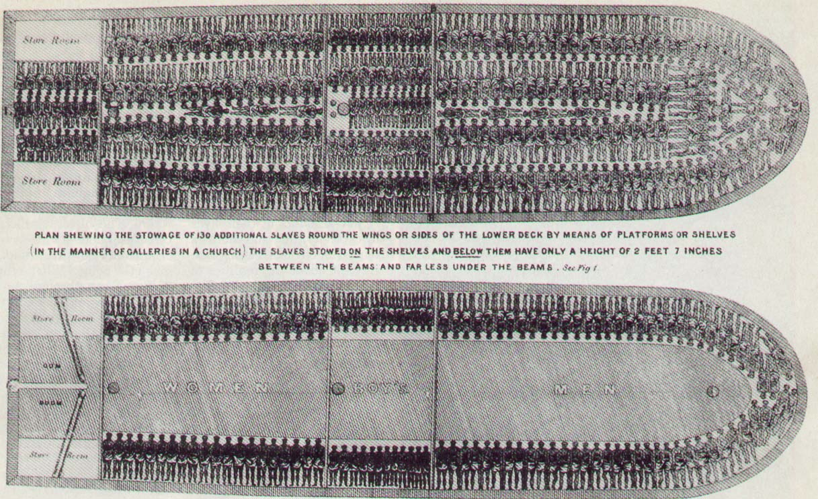
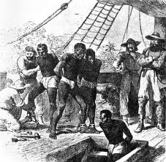
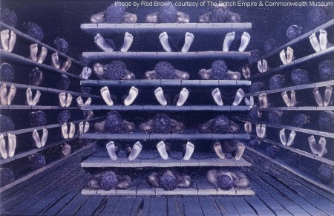
Middle Passage

Slide 11
“Coffin” Position: Onboard a Slave Ship

Slide 12
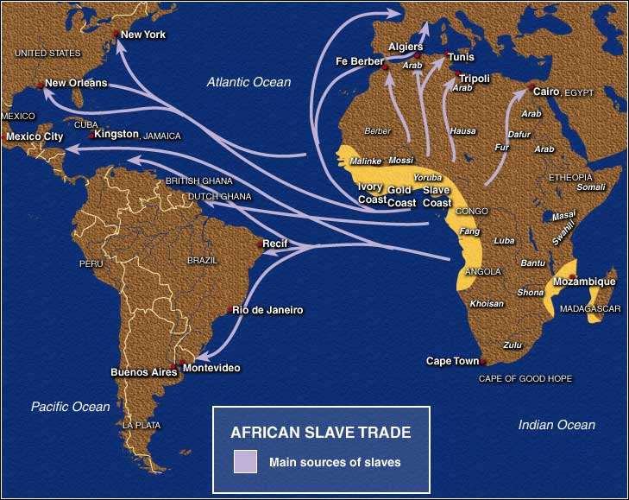

Slide 13
African Captives Thrown Overboard
Sharks followed the slave ships across the Atlantic!

Slide 14
The Atlantic Slave Trade
Slavery in the Americas
Auctioned off as property upon arrival to Americas
Families were broken up and sold to different buyers
Worked in mines or fields or as domestic servants
Were given little food and lived in small dreary huts
Forced to work long hours and suffered beatings
Was a lifelong condition and was hereditary as well
Africans used music and stories of their ancestors as modes of survival
Found ways to resist
Broke tools
Worked slowly
Ran away (dangerous)
Uprisings and revolts did occur

Slide 15
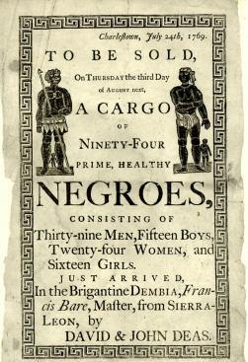
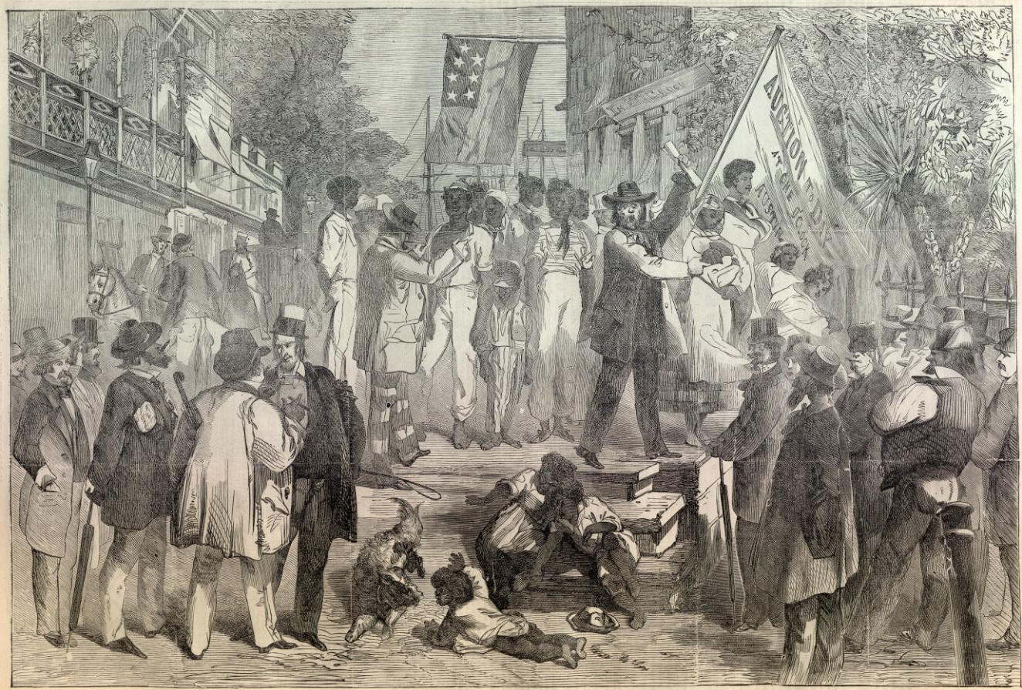

Slide 16
Inspection and Sale

Slide 17
Slave Master Brands

Slide 18
30 Lashes

Slide 19
Whipped Slave, early 19c

Slide 20
The Atlantic Slave Trade
Consequences of the Slave Trade
Numerous cultures lost generations of their fittest members
African families torn apart
Introduced guns to the African continent
Labor contributed greatly to economic power of the Americas
Brought African culture to the Americas (art, music, religion, and food)
Large African American population in the Americas today
Mixed races due to forced population

Slide 21
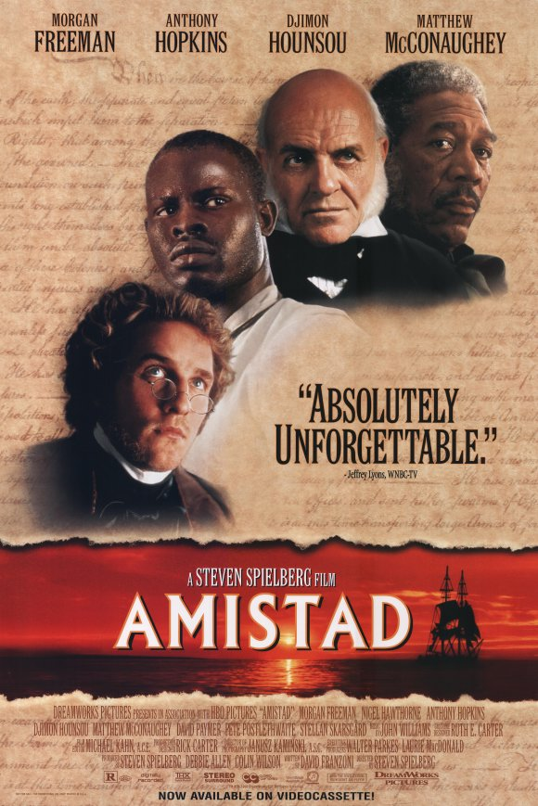
Amistad

